Slide 1
データベース基礎課題
提出はフリップ別にし、
通し閲覧できるものはGithub上で
確認いただけます。
Github URL:
小林 朝輝

Slide 2
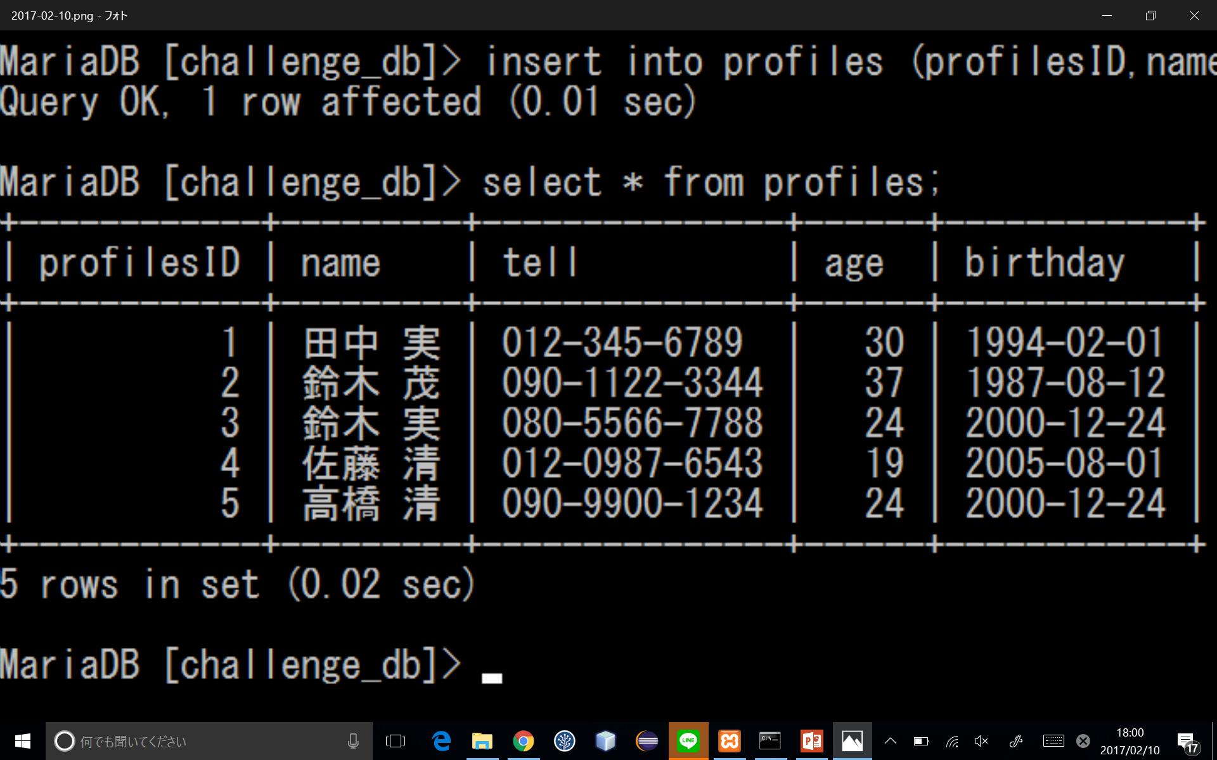
課題1 ～テーブルの作成とinsert～
create table profiles(profilesID int,name varchar(255),tell varchar(255),age int,birthday date);
insert into profiles (profilesID,name,tell,age,birthday)values(1,'田中 実','012-345-6789',30,'1994-02-01');
insert into profiles (profilesID,name,tell,age,birthday)values(2,'鈴木 茂','090-1122-3344',37,'1987-08-12');
insert into profiles (profilesID,name,tell,age,birthday)values(3,'鈴木 実','080-5566-7788',24,'2000-12-24');
insert into profiles (profilesID,name,tell,age,birthday)values(4,‘佐藤清’,‘012-0987-6543’,19,‘2005-08-01’);
insert into profiles (profilesID,name,tell,age,birthday)values(5,'高橋 清','090-9900-1234',24,'2000-12-24');

Slide 3
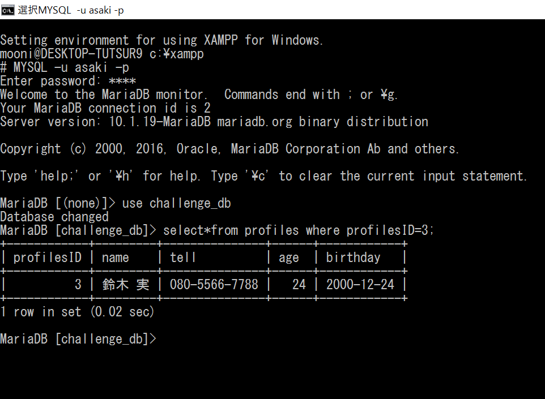
課題２ ～検索と表示～
MYSQL –u asaki –p
--------
use challenge_db
select * from profiles where profilesID=3;

Slide 4
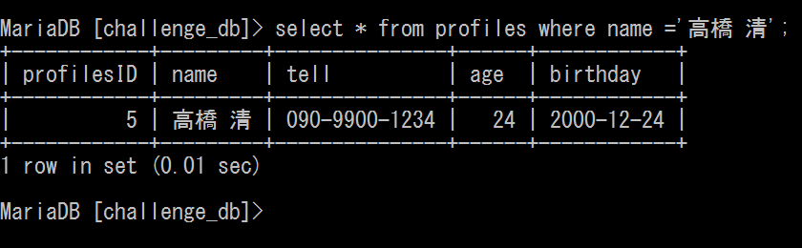
課題３ ～特定のレコードのみを検索、表示１～
MYSQL –u asaki –p
--------
use challenge_db
select * from profiles where name=‘高橋 清’;

Slide 5
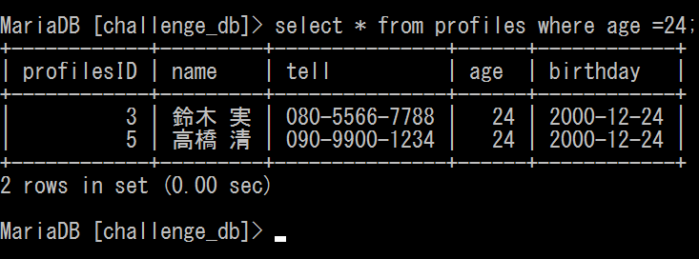
課題４ ～特定のレコードのみを検索、表示２～
select * from profiles where name ='高橋 清';

Slide 6
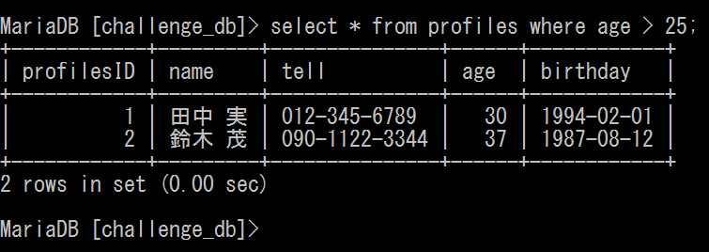
課題５ ～特定のレコードのみを検索、表示３～
select * from profiles where age > 25;

Slide 7
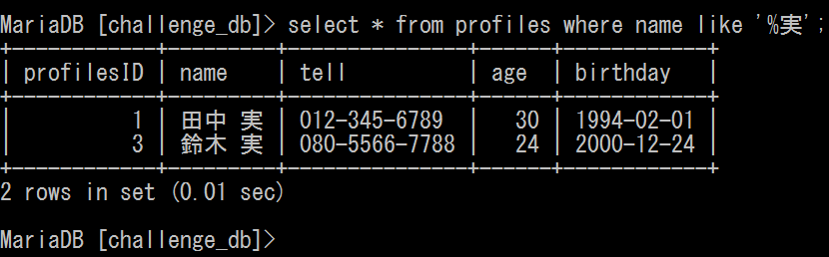
課題６ ～特定のレコードのみを検索、表示４～
select * from profiles where name like ‘%実’;

Slide 8
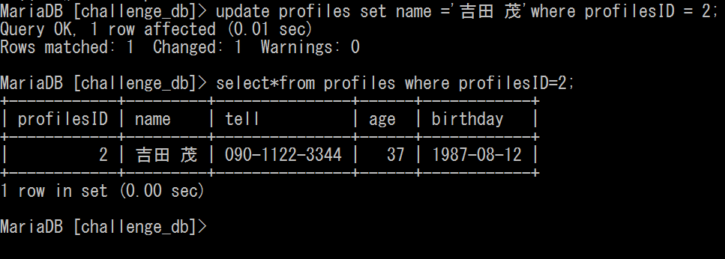
課題７ ～特定のレコードの更新～
update profiles set name =
‘吉田 茂’where profilesID =2;
select * from profiles where profilesID =2;

Slide 9
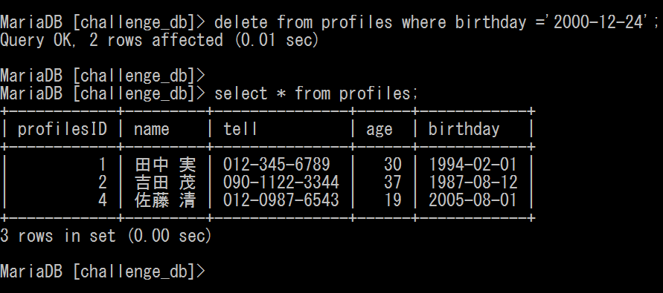
課題８ ～特定のレコードの削除～
delete from profiles where birthday =
‘2000-12-24’;
select * from profiles;

Slide 10
課題９
～Primary KeyとForeign Keyの宣言～
insert into profiles(profilesID,name,tell,age,birthday) values(3,'鈴木 実','080-5566-7788',24,'2000-12-24');
insert into profiles(profilesID,name,tell,age,birthday) values(5,'高橋 清','090-9900-1234',24,'2000-12-24');
update profiles set name ='鈴木 茂'where profilesID = 2;
select * from profiles order by profilesID;
alter table user change profilesID userID int primary key;
create table department(departmentID int primary key,departmentName varchar(255));
create table station(stationID int primary key,stationName varchar(255));
insert into department(departmentID,departmentName) values(1,'開発部');
insert into department(departmentID,departmentName) values(2,'営業部');
insert into department(departmentID,departmentName) values(3,'総務部');
insert into station(stationID,stationName) values(1,'九段下');
insert into station(stationID,stationName) values(2,'永田町');
insert into station(stationID,stationName) values(3,'渋谷');
insert into station(stationID,stationName) values(4,'神保町');
insert into station(stationID,stationName) values(5,'上井草');

Slide 11
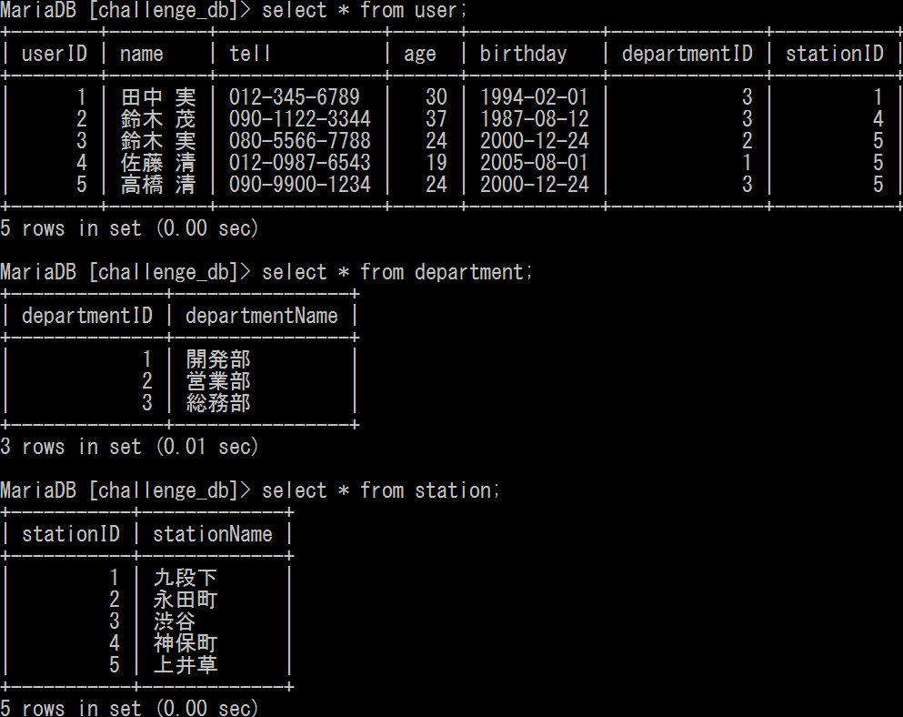
～Primary KeyとForeign Keyの宣言～
alter table user add (departmentID int,foreign key (departmentID) references department (departmentID));
alter table user add (stationID int,foreign key (stationID) references station (stationID));
update user set departmentID = 3 where userID =1;
update user set departmentID = 3 where userID =2;
update user set departmentID = 2 where userID =3;
update user set departmentID = 1 where userID =4;
update user set departmentID = 3 where userID =5;
update user set stationID = 1 where userID =1;
update user set stationID = 4 where userID =2;
update user set stationID = 5 where userID =3;
update user set stationID = 5 where userID =4;
update user set stationID = 5 where userID =5;
select * from user;
select * from department;
select * from station;

